Slide 1
Migration and its representation on social media in Bulgaria
Justine Toms
New Bulgarian University

Slide 2
About the EUMEPLAT Project
10 countries
2020-2024

Slide 3
Migration as a topic
1. Migration topic is very important for Bulgaria – we are a border line.
2. Legislation is old and not very good.
3. The institutions are helpless, give up and do nothing or very little – example – build a wall

Slide 4
Migration as a topic
The migration processes as topic are not presented very often on the traditional Bulgarian media.
The debate is very low and just in some cases the topic emerges for a while, mainly related with some negative stories and then all is back to “normal”.

Slide 5
Migration topic on the SM in Bulgaria
On the social media there are many channels and accounts which just “copy/paste” same info, very often with “neutral” sentiment, but leading to fake news websites or distributing mainly fake news content. They just „flood” the social media and no real debate is going on.
The coverage is dominated by the national perspective and mainly by the criminal aspect of people’s traffic and the national authorities dealing with this issue.

Slide 6
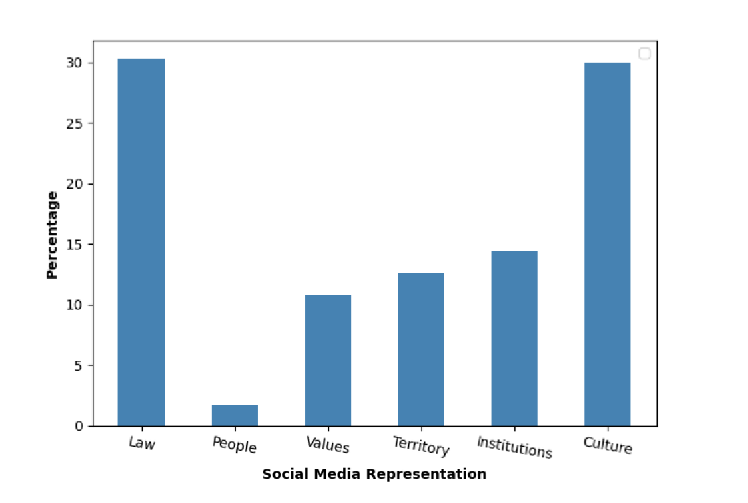
Migration on SM

Slide 7
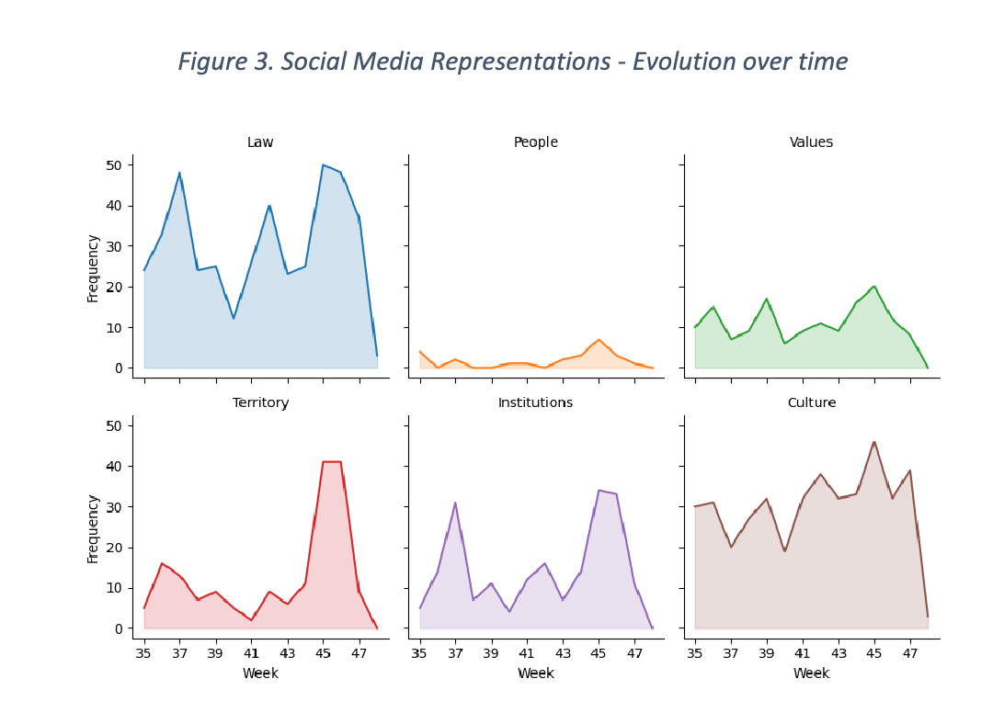
Migration on SM

Slide 8
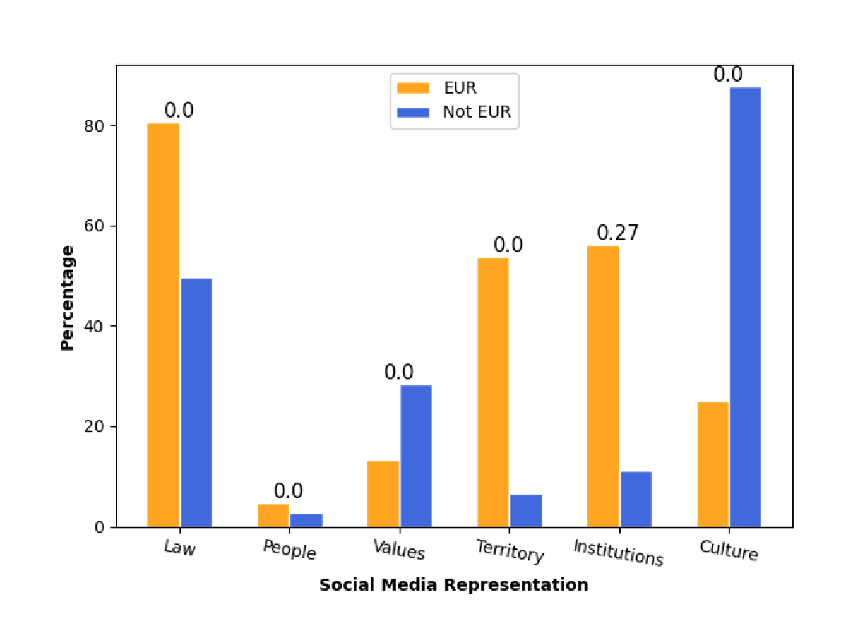
Migration on SM

Slide 9
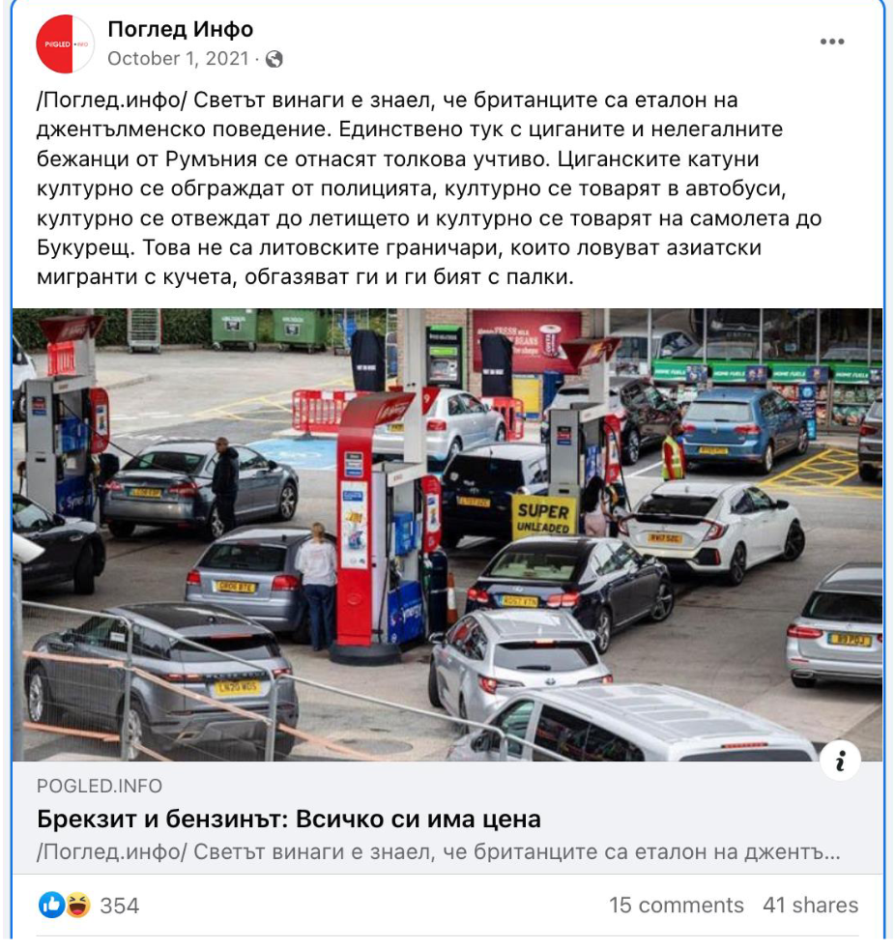
Examples

Slide 10
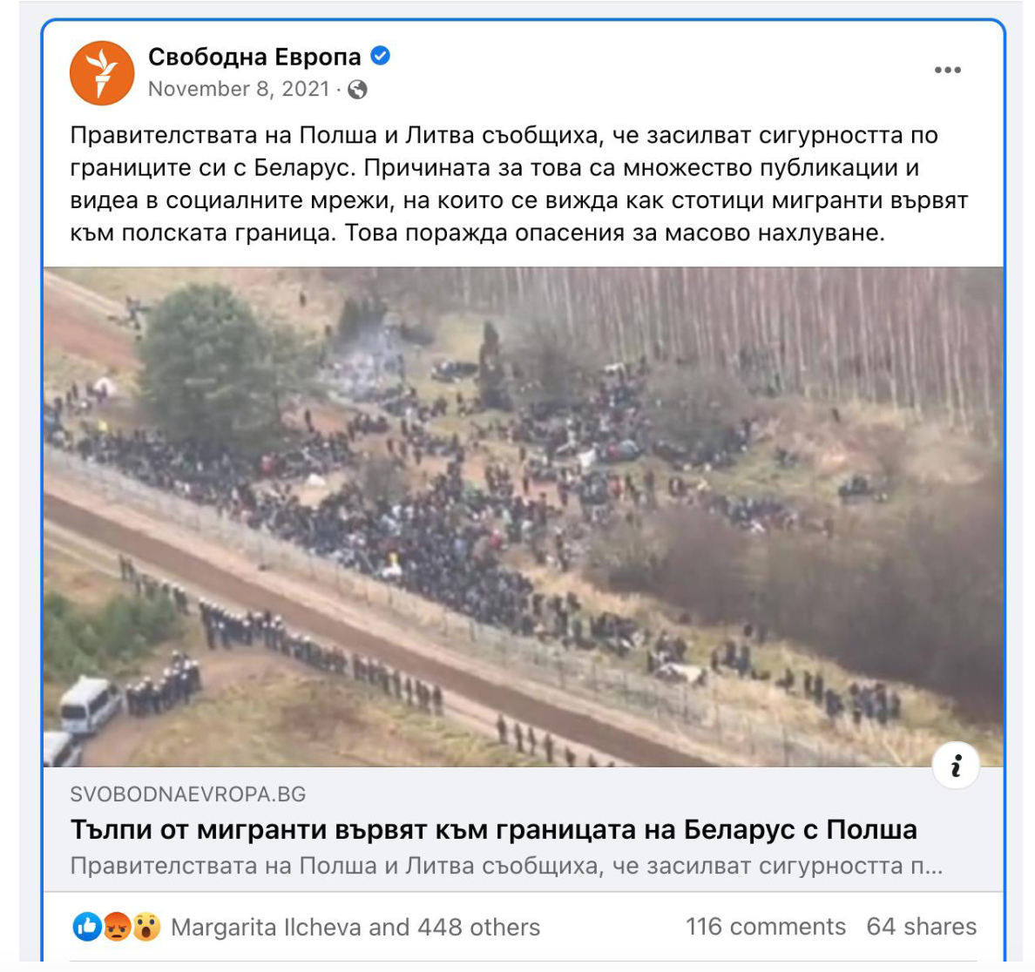
Examples

Slide 11
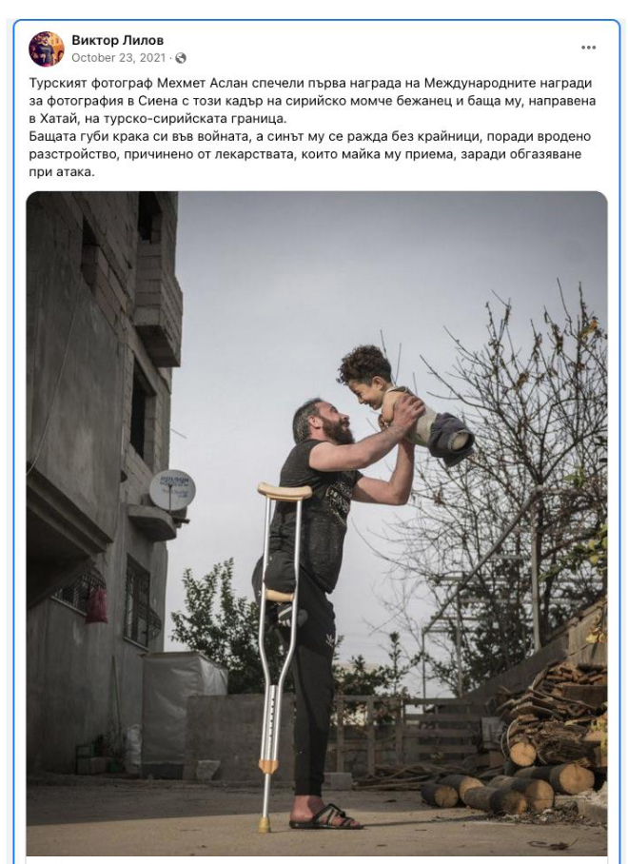
Examples

Slide 12
Three main findings – Migration on SM in Bulgaria
1. Migration topic is not often on the media / social media with other then violence / breaking the law.
2. Many fake websites and accounts spreading ”blah-blah” or missinformation and fake news.
3. Positive voice, people’s point of view and storytelling are on the media very rarely.

Slide 13
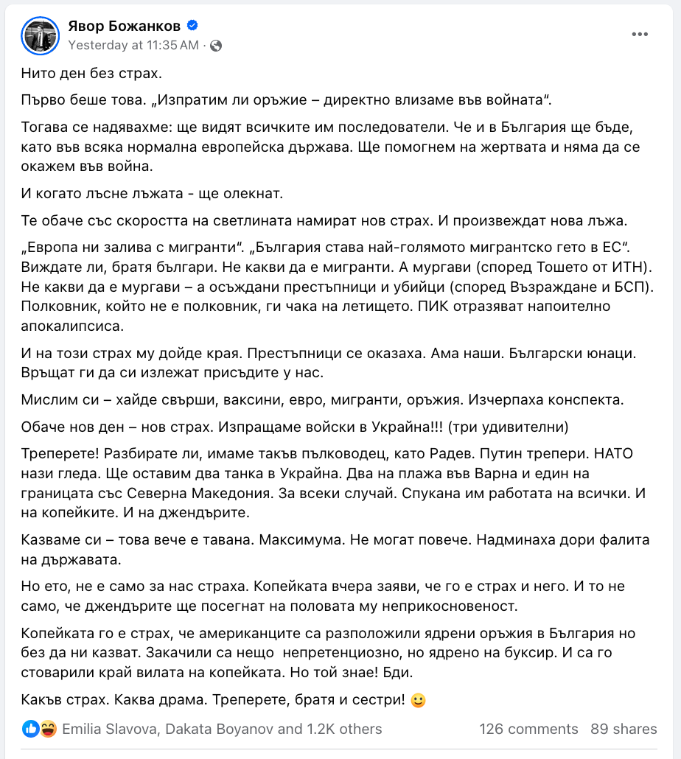
Three best practices - Migration
1. Influencers taking the topic – rarely, but positive

Slide 14
Three best practices - Migration
2. Media literacy trainings for different groups of people

Slide 15
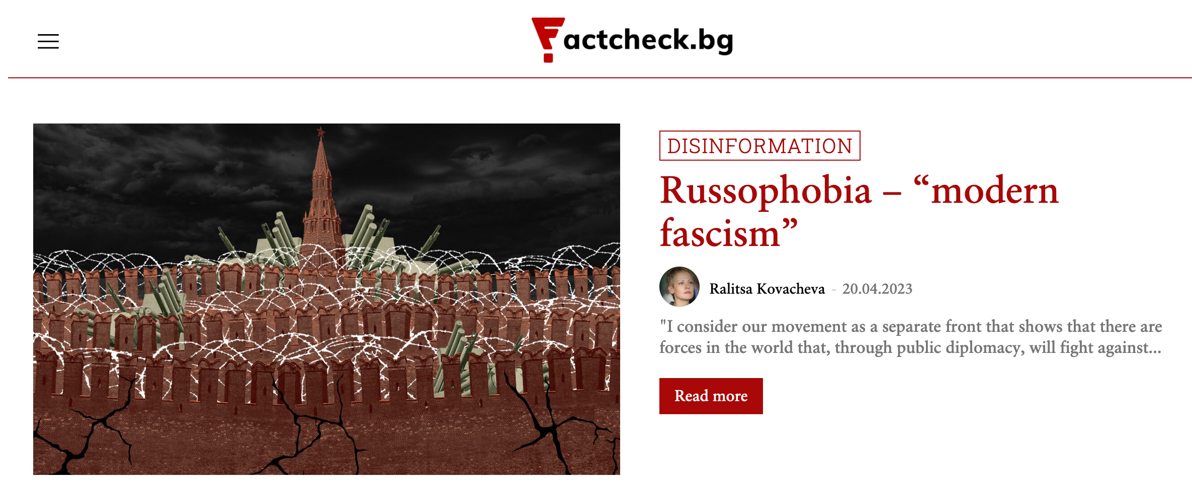
Three best practices - Migration
3. https://factcheck.bg/

Slide 16
Thank you for your attention!
Justine Toms
New Bulgarian University

